Slide 1
TPL Dataflow The best little async library you’ve never heard of…
From the docs:
The Task Parallel Library (TPL) provides dataflow components to help increase the robustness of concurrency-enabled applications.
What it actually does is give you the tools to create in-process async pipelines in a simple, structured manner.
And I'm betting that like me (until recently), this is a library you'll never even have heard of.
I'll cover the basics - Sources, Targets and Blocks - and how to link them together into useful **asynchronous** and **parallel** pipelines within your programs.
We'll handle error conditions, cancellation and how to control the degree of parallelism - with samples that give you a bit more than "Hello World".
W: https://www.hammond-turner.org.uk
E: joel@Hammond-turner.org.uk
T: @Rammesses

Slide 2

TPL Dataflow
The best little async library you’ve never heard of…
Joel Hammond-Turner
e: joel@hammond-turner.org.uk
t: @rammesses

Slide 3
What is the TPL Dataflow Library?
“The Task Parallel Library provides dataflow components to help increase the robustness of concurrency-enabled applications.”
“The Task Parallel Library provides dataflow components to help increase the robustness of concurrency-enabled applications.”

Slide 4
What is the TPL Dataflow Library?
TPL Dataflow promotes actor/agent-oriented designs through primitives for in-process message passing, dataflow, and pipelining. TDF builds upon the APIs and scheduling infrastructure provided by the Task Parallel Library (TPL), and integrates with the language support for asynchrony provided by C#, Visual Basic, and F#.
TPL Dataflow promotes actor/agent-oriented designs through primitives for in-process message passing, dataflow, and pipelining. TDF builds upon the APIs and scheduling infrastructure provided by the Task Parallel Library (TPL), and integrates with the language support for asynchrony provided by C#, Visual Basic, and F#.

Slide 5
What is the TPL Dataflow Library?
Actor/agent components for asynchronous dataflow / pipelines

Slide 6
But, WHAT is the TPL Dataflow Library?

Slide 7
It’s all about the Blocks
ITargetBlock<T>
Input Buffer
IDataflowBlock
Activity
ISourceBlock<V>
Output Buffer

Slide 8
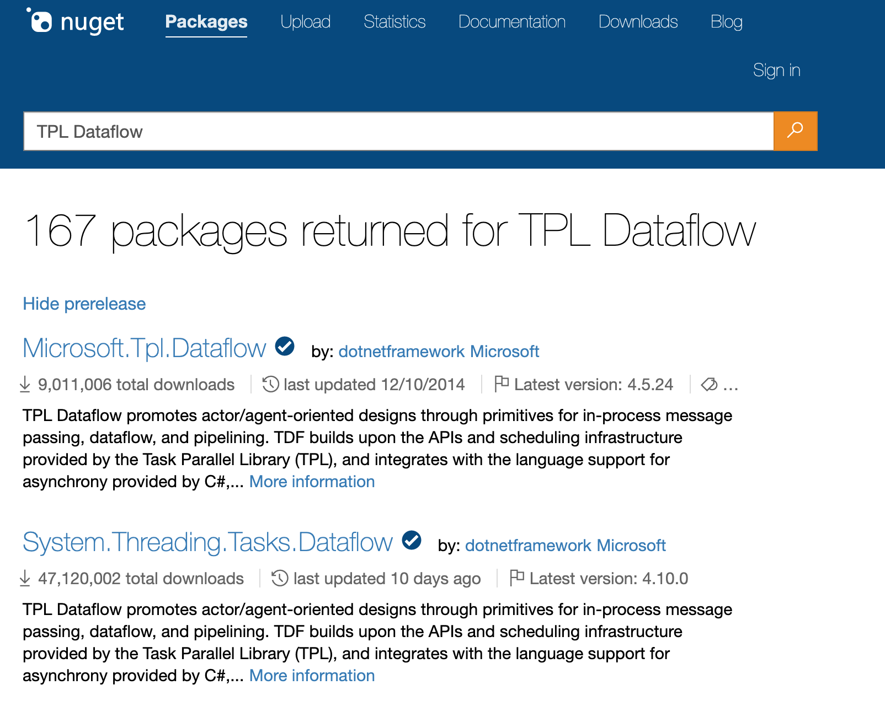
Getting the TPL Dataflow Library

Slide 9
Getting the TPL Dataflow Library
Add via NuGet
> dotnet add package System.Threading.Tasks.Dataflow
PM> install-package System.Threading.Tasks.Dataflow

Slide 10
What’s in the box?
Buffering Blocks
BufferBlock
BroadcastBlock
Execution Blocks
ActionBlock
TransformBlock
Grouping Blocks
BatchBlock
JoinBlock
WriteOnceBlock
TransformManyBlock
BatchedJoinBlock

Slide 11
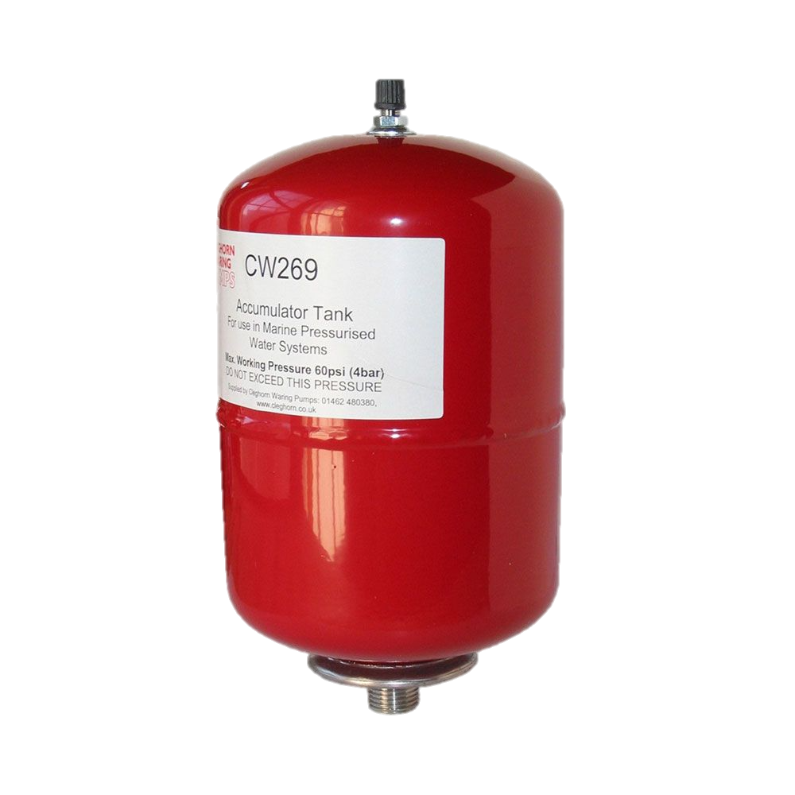
Buffering Blocks
Buffering blocks hold data for use by data consumers.
BufferBlock<T> - FIFO Queue
BroadcastBlock<T> - Capture & replay latest value posted
WriteOnceBlock<T> - Capture & replay a single constant value

Slide 12
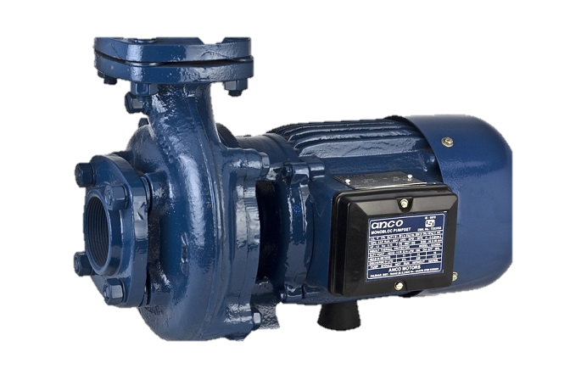
Execution Blocks
Execution blocks call a user-provided delegate for each piece of received data.
ActionBlock<TInput> - Do work
TransformBlock<TInput,TOutput> - Do work on a thing & return another thing
TransformManyBlock<TInput,TOutput> - Do work on a thing & return zero or many other things

Slide 13

Grouping Blocks
Grouping blocks combine data from one or more sources and under various constraints.
BatchBlock<T> - Buffer input and output as batches
JoinBlock<T1,T2> - Merge 2 (or 3) streams and output a stream of tuples
BatchedJoinBlock<T1,T2> - Merge 2 (or 3) streams and output a stream of batches of tuples

Slide 14
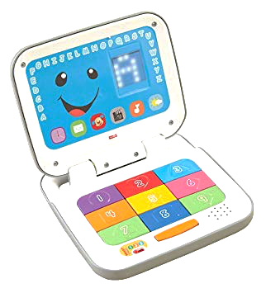

My First TPL Dataflow
Generator
Buffer
Action
SHOW ME THE CODE!

Slide 15
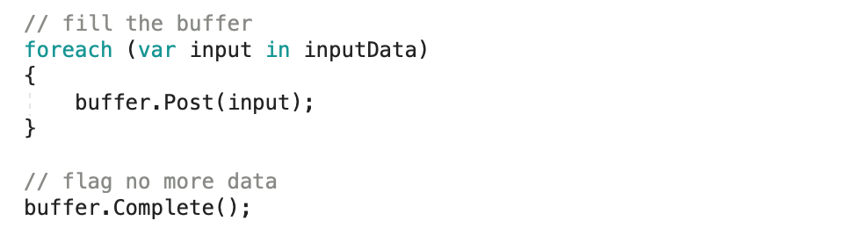
My First TPL Dataflow
Use Post / SendAsync to get data into a block
Don’t forget to call Complete!

Slide 16
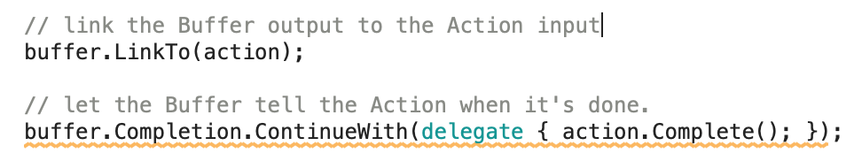
My First TPL Dataflow
Outputs Link to Inputs
Don’t forget to chain the Completion event!

Slide 17
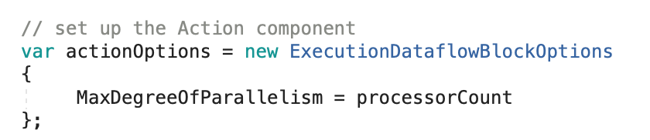
My First TPL Dataflow
Execution Blocks execute serially
Unless you specify parallelism!

Slide 18
What Else can you do with TPL Dataflow?

Slide 19
Write your own Dataflow Blocks!
How? Let me count the ways…
Inherit from the OOB Blocks
Implement IPropagatorBlock<T, V> or use DataBlock.Encapsulate
Implement IDataflowBlock
Implement ISourceBlock<T> / IReceivableSourceBlock<T>
Implement ITargetBlock<T>

Slide 20
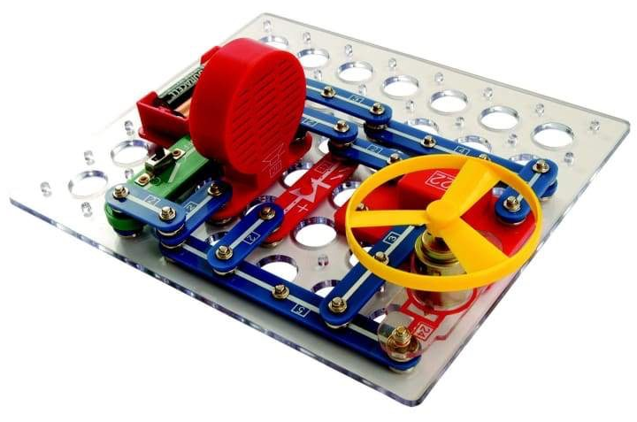
Something a bit more complex
Generator
Get Wikipedia Data (Transform Block)
Summarise (Custom Block)
Display (ActionBlock)
SHOW ME THE CODE!

Slide 21

Something a bit more complex
Writing custom blocks isn’t hard
Don’t forget to implement all the interfaces
Don’t forget to call / chain Complete() as required…

Slide 22


Split & Join - Doubles anyone?
Generator
Get Wikipedia Data (ActionBlock)
Make Pairs (JoinBlock)
SHOW ME THE CODE!
Output (ActionBlock)
Make Matches (BatchBlock)

Slide 23
TPL Dataflow Library is Async Plumbing

Slide 24
In Summary
TPL Dataflows are
Actor / agent components for asynchronous dataflow / pipelines
Not hard to get your head around…
But not hard to use
IN MEMORY!
For persistent flows use Azure ServiceBus & Stateful Functions!

Slide 25
TPL Dataflow
The best little async library you’ve never heard of…
Repo: https://bit.ly/TPLDataflow-Repo
Deck: https://bit.ly/TPLDataflow-Deck
Joel Hammond-Turner
e: joel@hammond-turner.org.uk
t: @rammesses

